Slide 1
2025
Tax Scams & How to Avoid Them
Communications & Liaison
Stakeholder Liaison
presented by
Dan Arnell Belarmino
IRS Stakeholder Liaison

Slide 2

IRS Dirty Dozen Tax Scams
2

Slide 3

Email Phishing Scams
3

Slide 4

Bad Social Media Advice
4

Slide 5
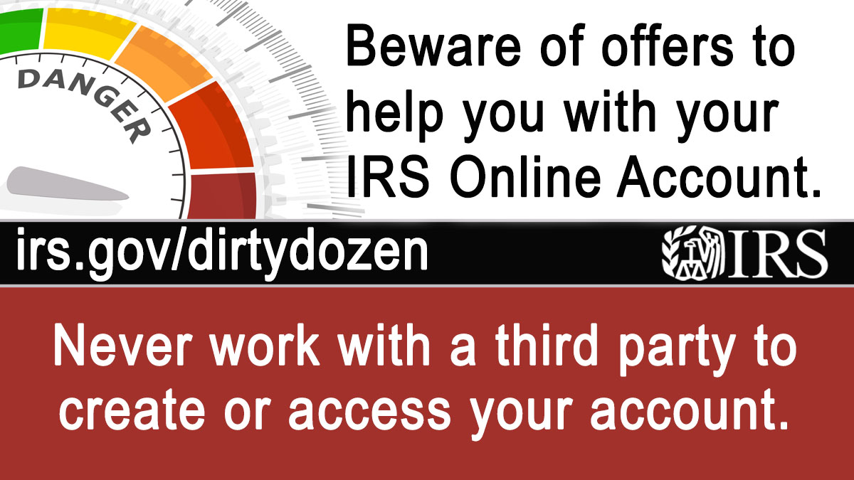
IRS Individual Online Account “Help” from Scammers
5

Slide 6

Fake Charities
6

Slide 7

False Fuel Tax Credit Claims
7

Slide 8

Credits for Sick Leave and Family Leave
8

Slide 9

Bogus self-employment tax credit
9

Slide 10
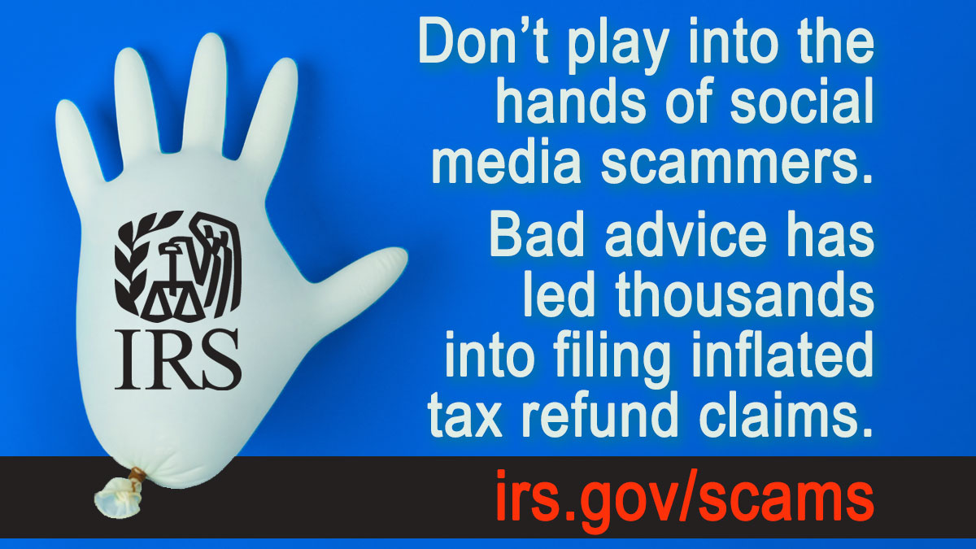
Improper household employment taxes
10

Slide 11

The Overstated Withholding Scam
11

Slide 12

Misleading Offers in Compromise
12

Slide 13

Ghost Tax Return Preparers
13

Slide 14

New Client Scams and Spear Phishing
14

Slide 15

Watch Out for Other Abusive Schemes
15

Slide 16
Recovering from a Scam: Protecting Finances
16
Immediately stop interacting with the scammer
Don’t send money or share personal information
Contact financial institutions

Slide 17
Recovering from a Scam: Protecting Tax Information
17
Get an Identity Protection PIN (IP PIN)
Set up an IRS tax account
  Accounts are available for
    Individuals
    Businesses and
    Tax professionals
Monitor the IRS tax account activity

Slide 18
Recovering from a Scam: Report Loss of Identity
18
If a taxpayer’s Social Security Number (SSN) or Individual Tax Identification Number (ITIN) was stolen, report it to:
  IdentityTheft.gov
  IRS by submitting Form 14039, Identity Theft Affidavit
  Their state tax agency

Slide 19

How to Report an Abusive Tax Scheme
19
Visit IRS.gov/scams
Complete Form 14242, Report Suspected Abusive Tax Promotions or Preparers
  Submit online
  or
  Mail/fax to the IRS Lead Development Center

Slide 20
Online Account for Individuals

Slide 21





Individual Online Account
Secure access to individual tax information
Understand tax obligations
Authorize tax professionals
Pay taxes, resolve issues and stay tax compliant
Track account status and sign up for email alerts
2

Slide 22
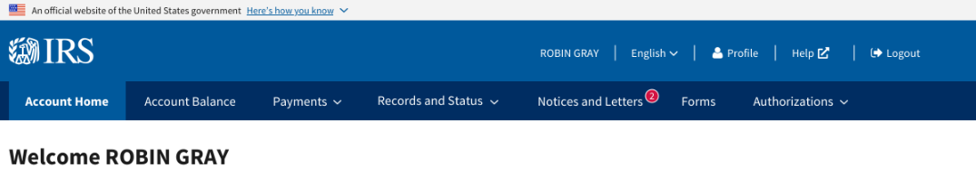
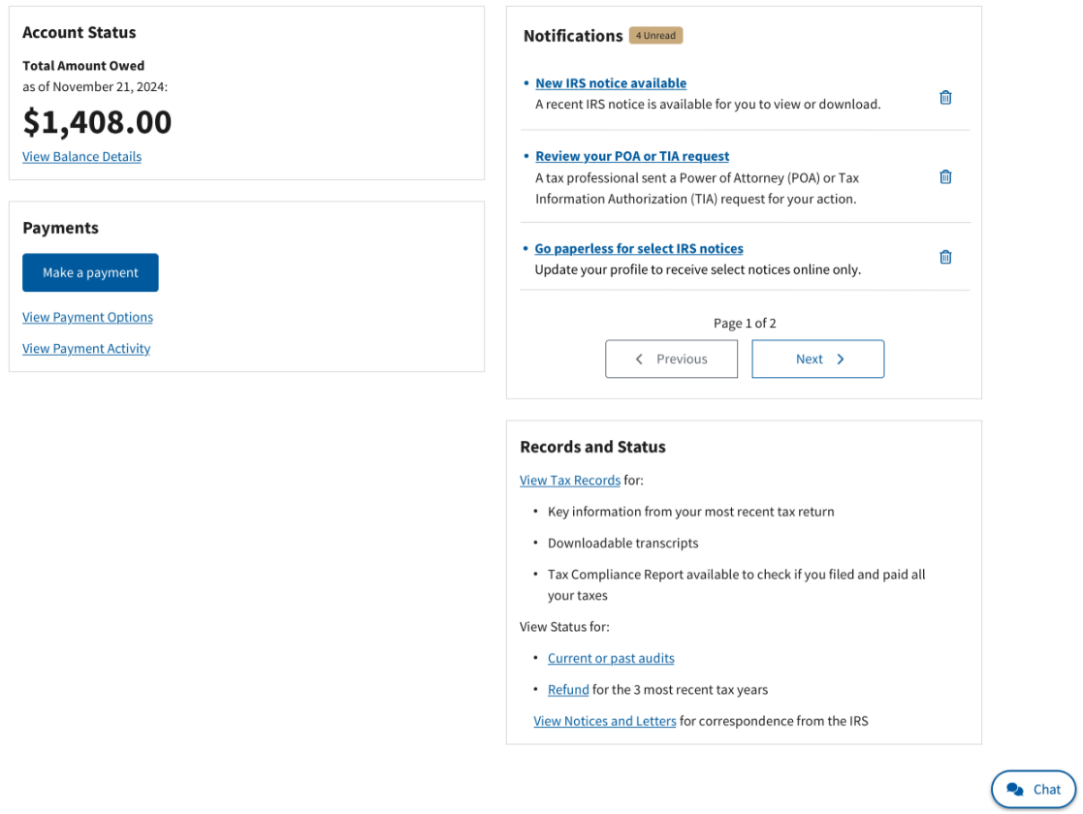
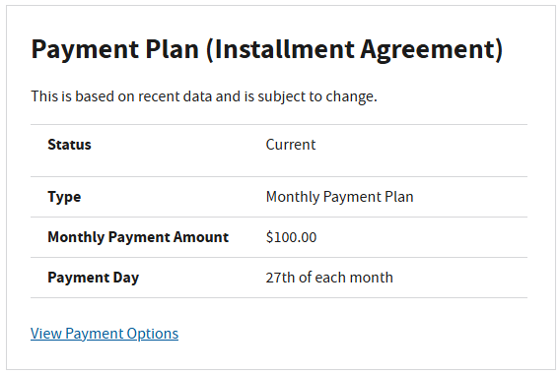
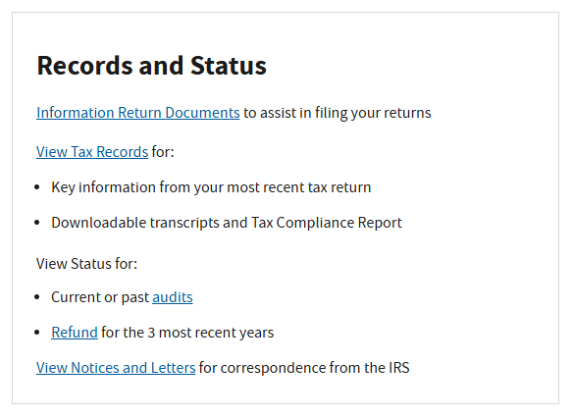
Individual Online Account Options
Language Preference
Select for information in Spanish.
Profile
Get email notifications, save bank accounts and get an identity protection personal identification number (IP PIN).
Account Status
View total amount owed, with details by tax year and tax module.
Notifications
Review and approve power of attorney, tax information authorization and income verification requests online.
Make a Payment
Pay federal taxes, view payment history, schedule or cancel payments.
Records and Status
View information returns, tax records, audit or refund status, and notices.
Payment Plans
Create or revise a short or long-term payment plan.
Virtual Assistant and Live Chat
Find information to address payment needs or escalate to IRS live chat.
3

Slide 23
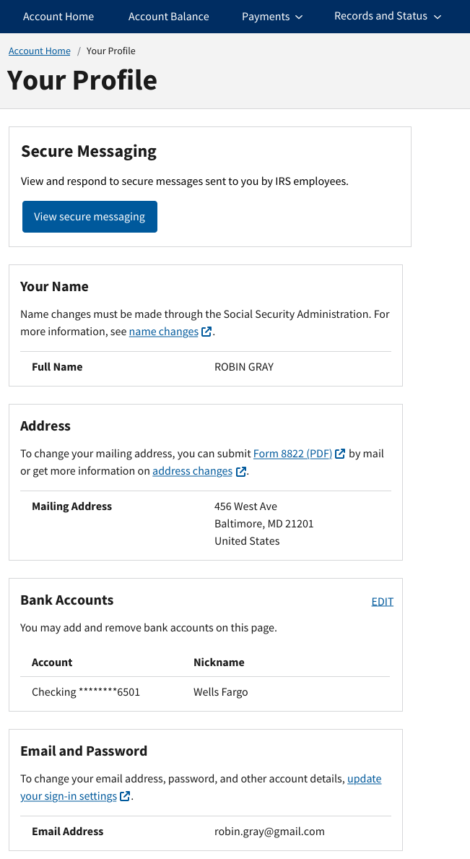
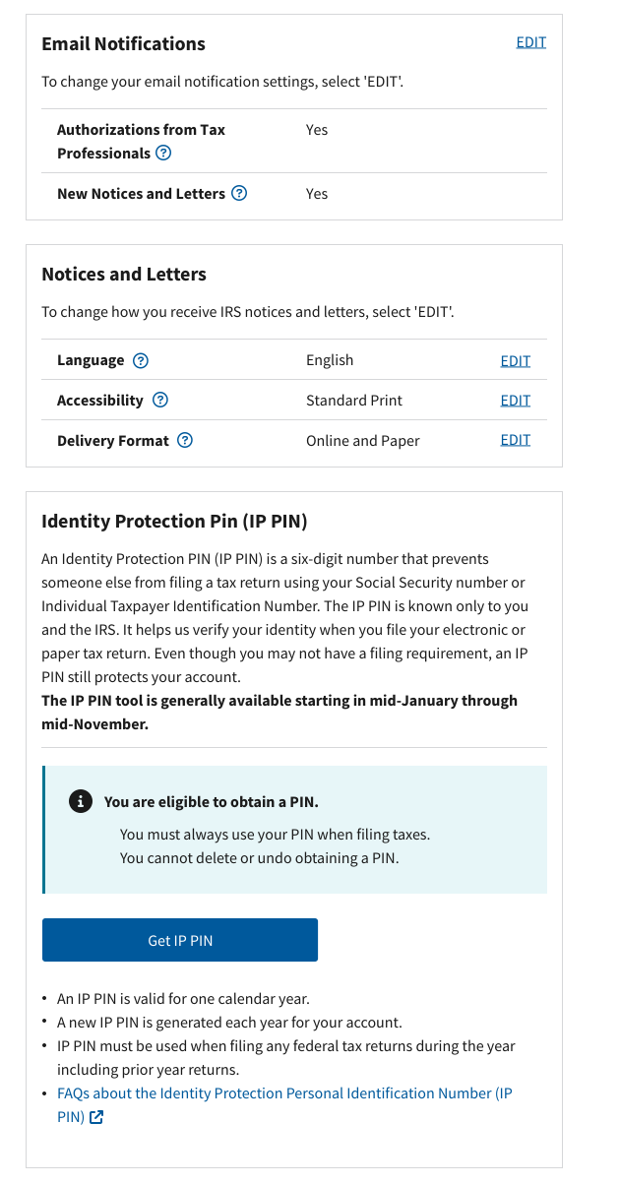
Profile
Profile
Get email notifications.
Save bank accounts.
Go paperless for IRS digital notices.
Select language and format preferences for paper notices.
Obtain an identity protection PIN (IP PIN).
4

Slide 24
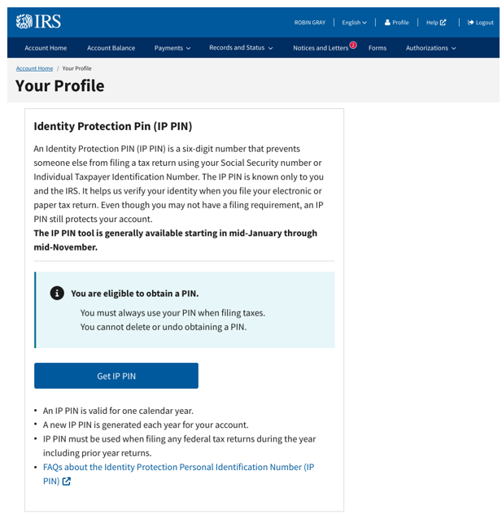
Identity Protection Personal Identification Number (IP PIN)
How It Works
Once you have opted in and obtained an IP PIN online, you will need to retrieve your IP PIN online each calendar year.
The IP PIN is generally available in your online account starting in mid-January through mid-November.
5

Slide 25
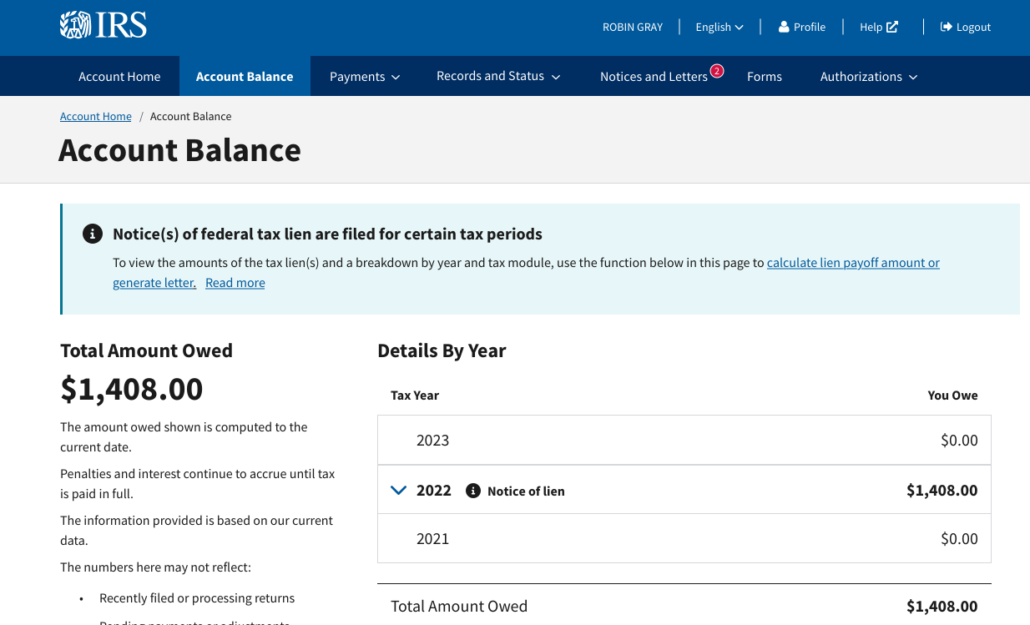
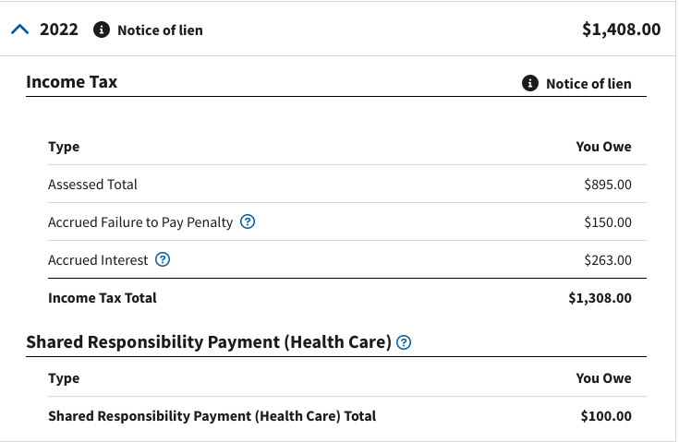
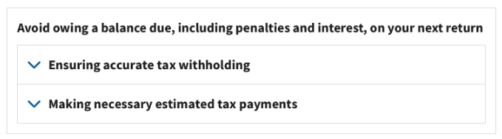
Account Balance
Account Balance
View total amount owed, with details by tax year and by tax module.
View guidance to prevent balance due for future tax filing.
6

Slide 26
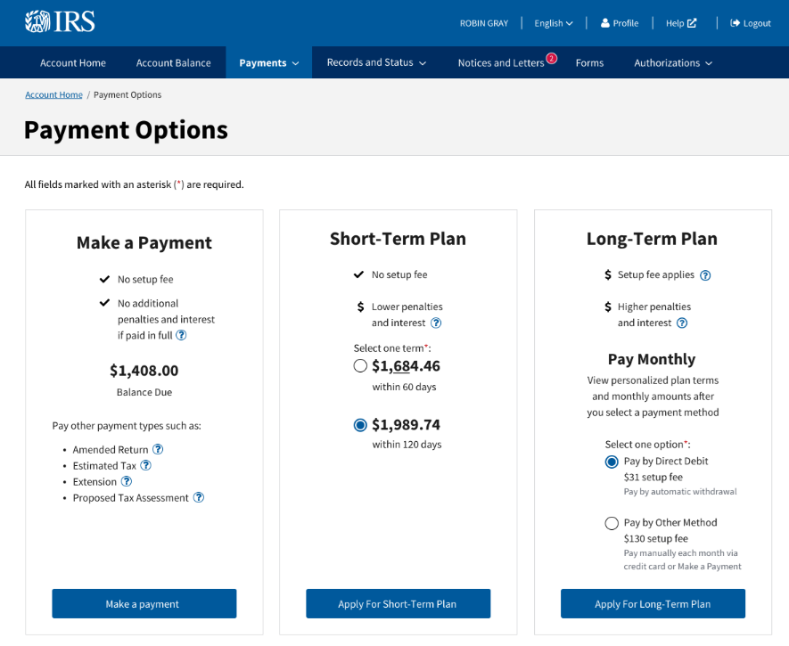
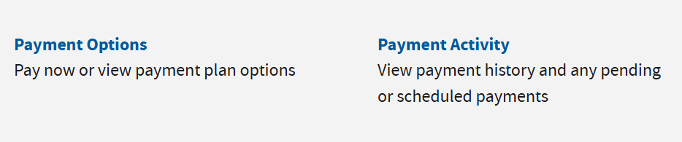
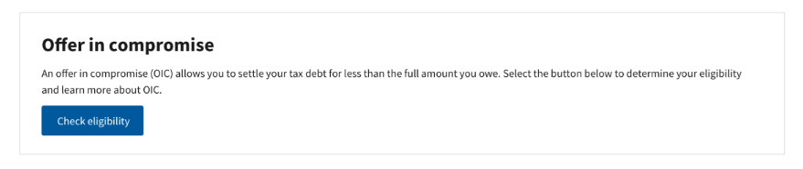
Payment Options
Payment Options
Make same-day payments or schedule payments up to 365 days in the future using a bank account.
Create or revise a short or long-term payment plan, or a pending or pre-assessed payment plan.
Offer in compromise.
7

Slide 27
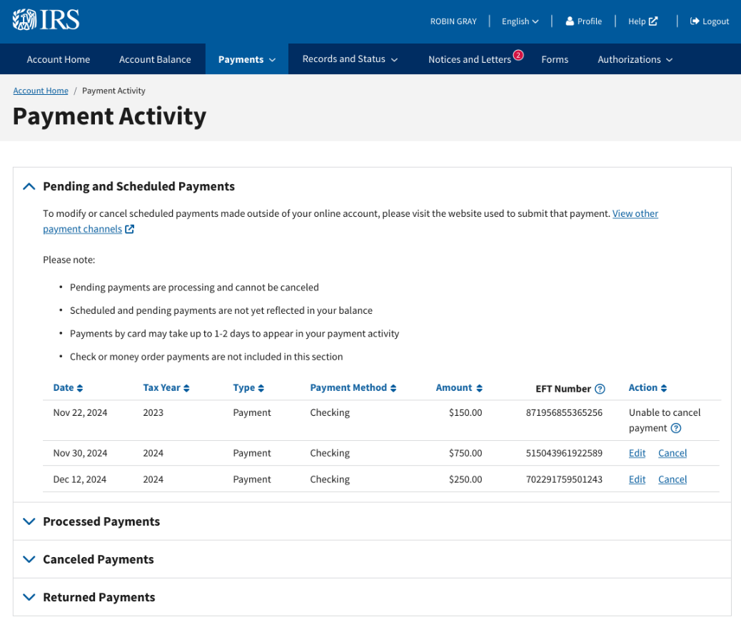

Payment Activity
Payment Activity
View pending, scheduled, processed, cancelled and returned payments.
View up to five years of payment history.
8

Slide 28
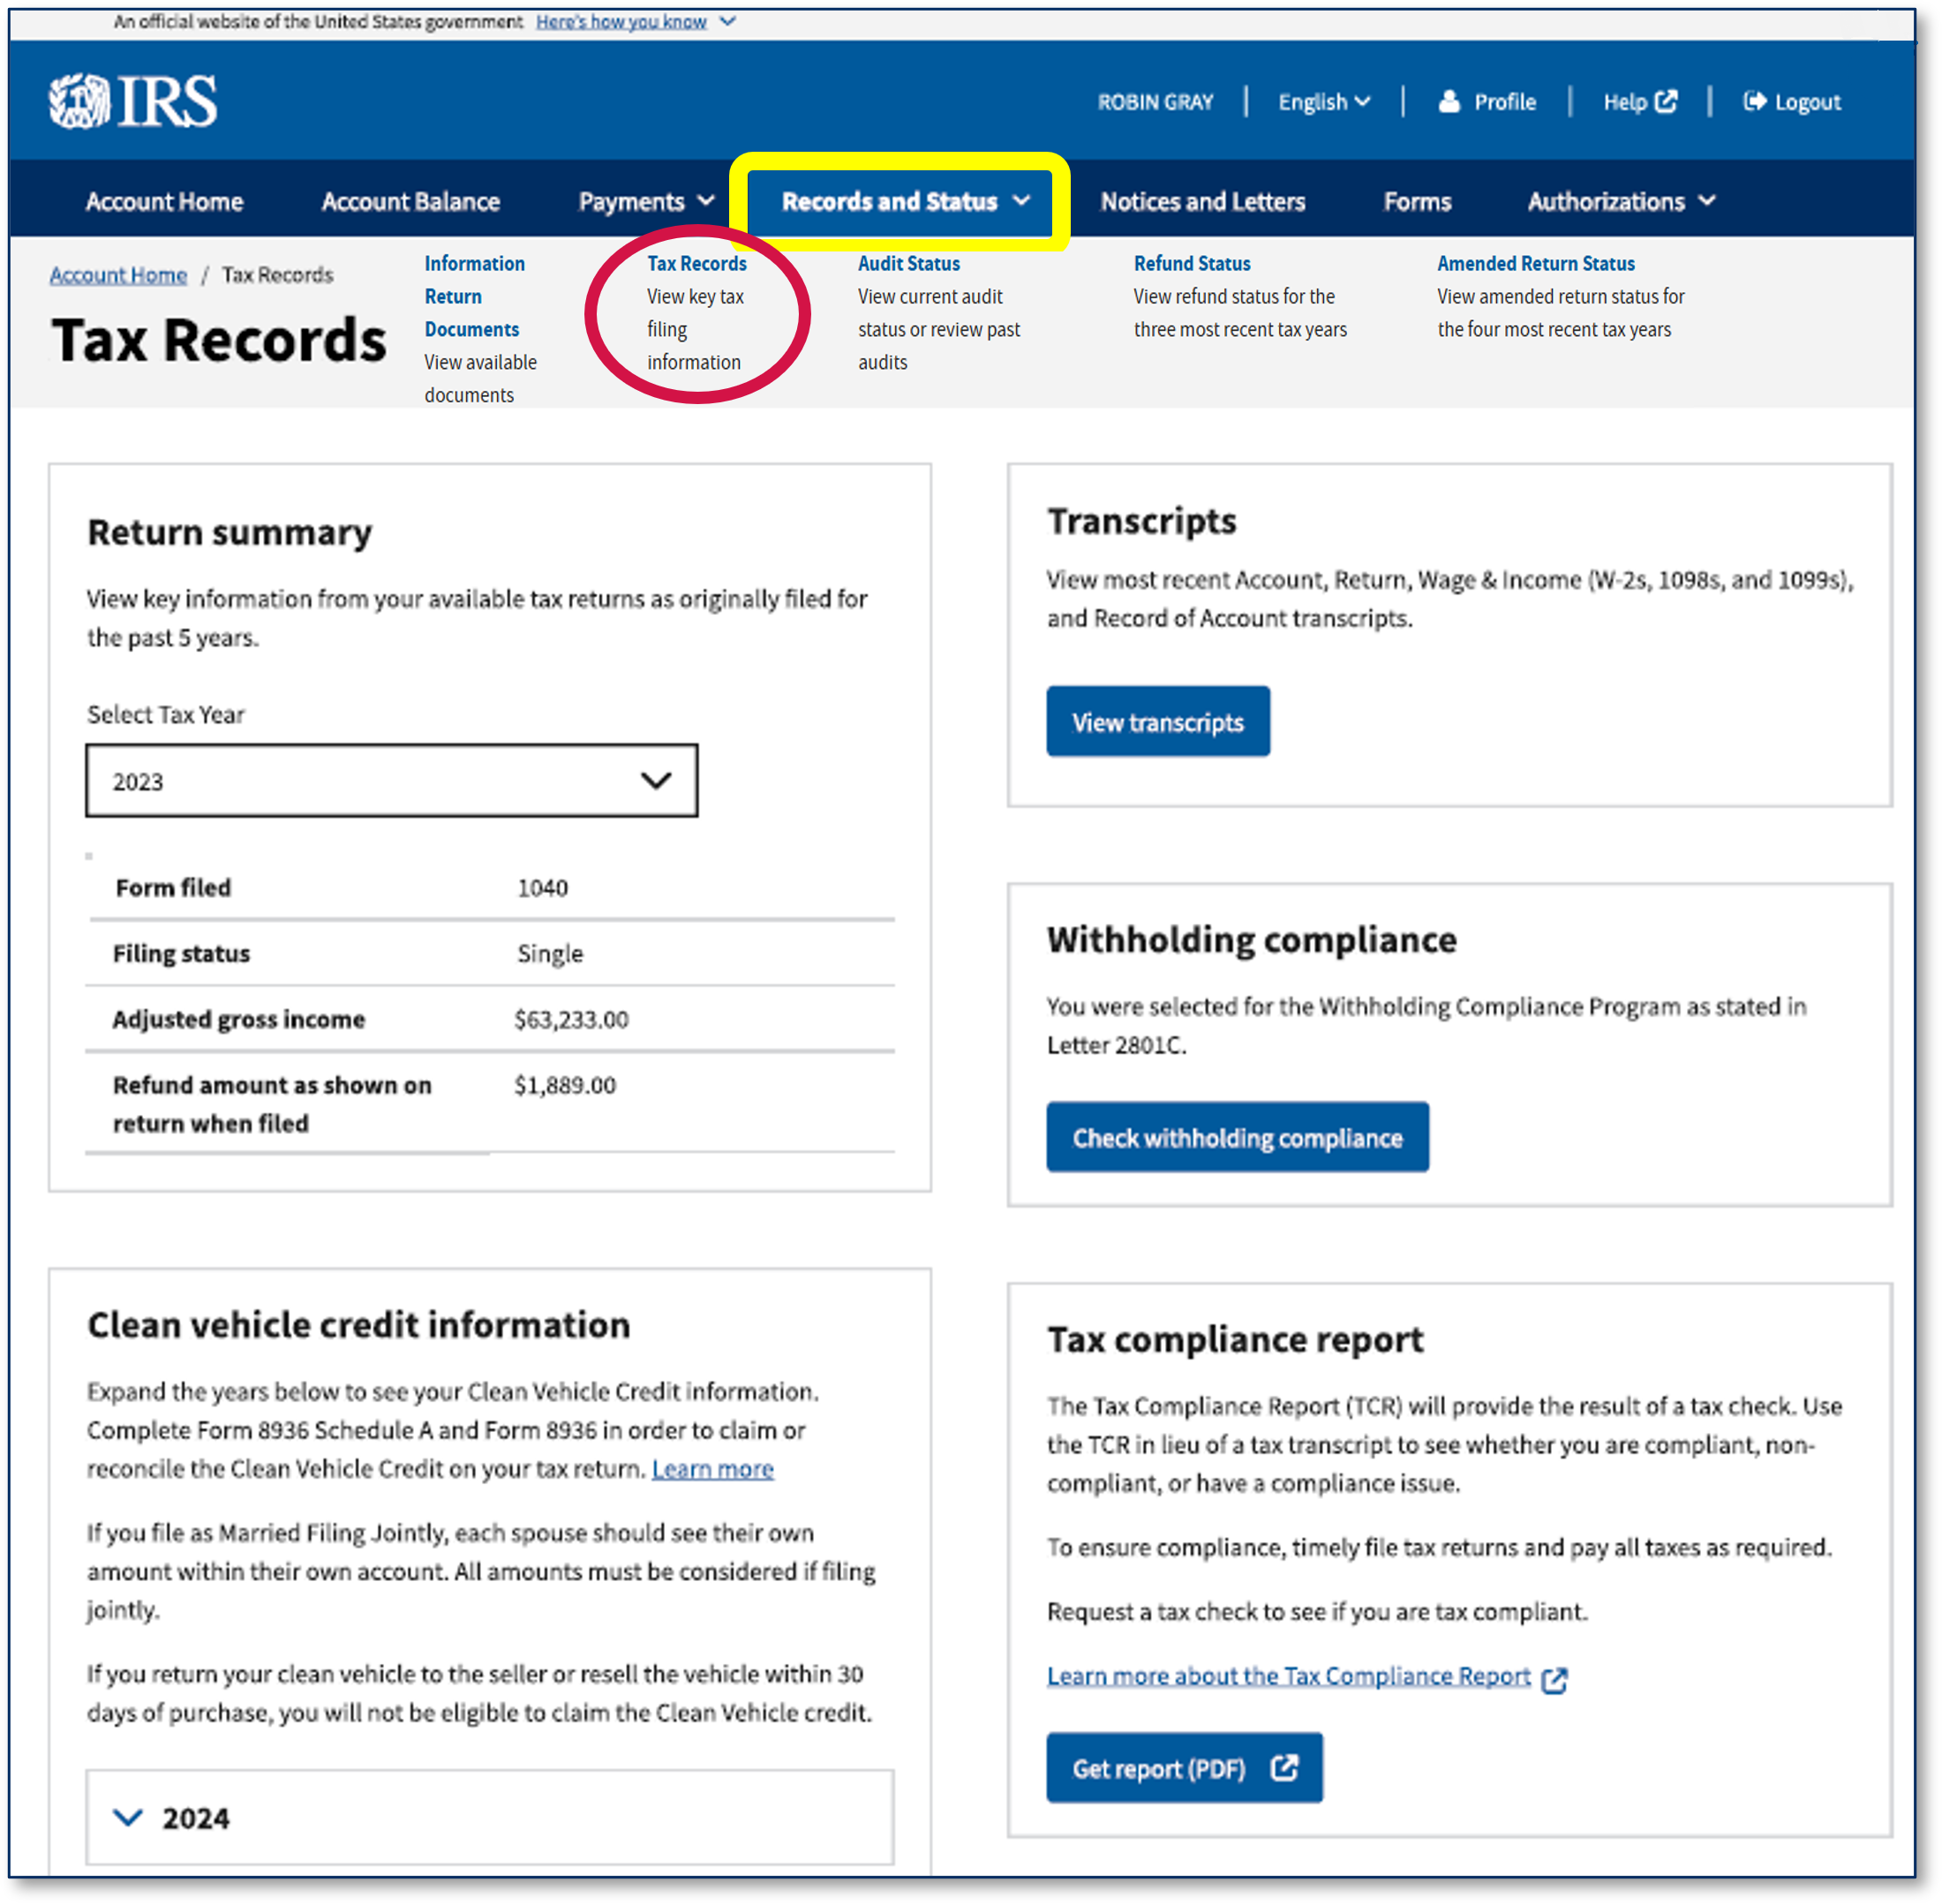
Tax Records
Tax Records
Recently filed tax return
Clean vehicle credit
Tax compliance report
Transcripts
9

Slide 29
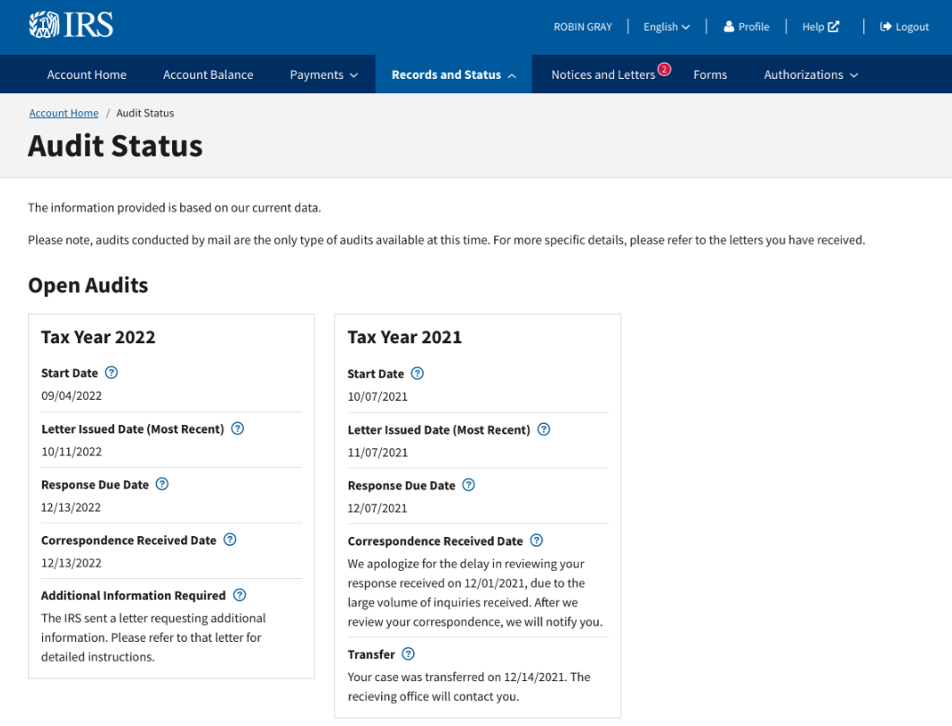
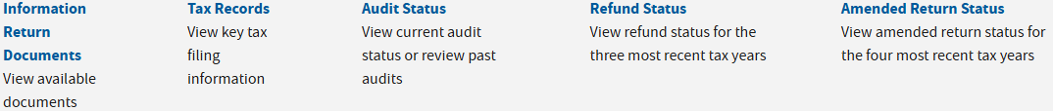
Audit Status
Audit Status
View latest status on certain types of audits conducted by mail.
Includes status for open and closed audits.
10

Slide 30
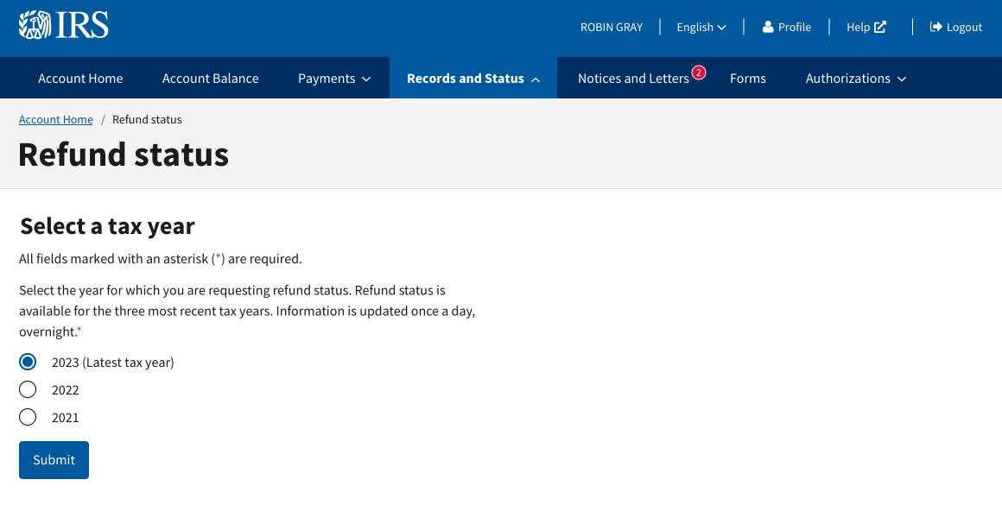
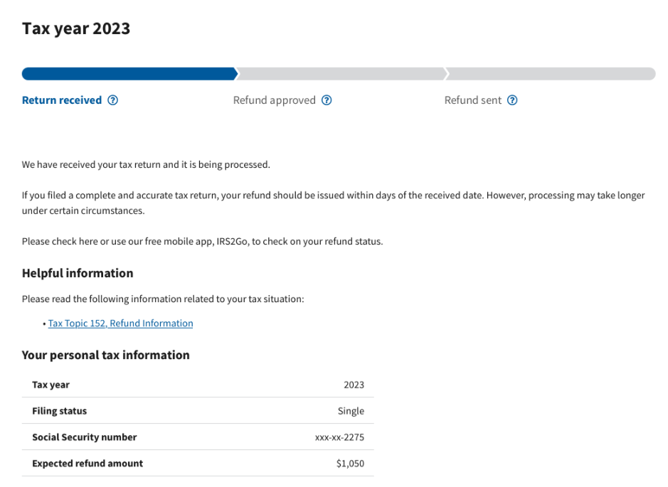
Refund Status
How It Works
View up-to-date refund status for the latest three tax years.
11

Slide 31
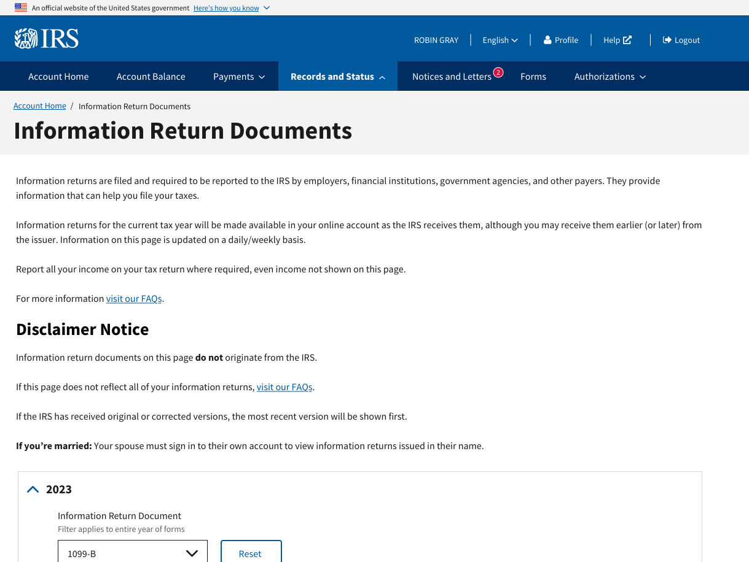
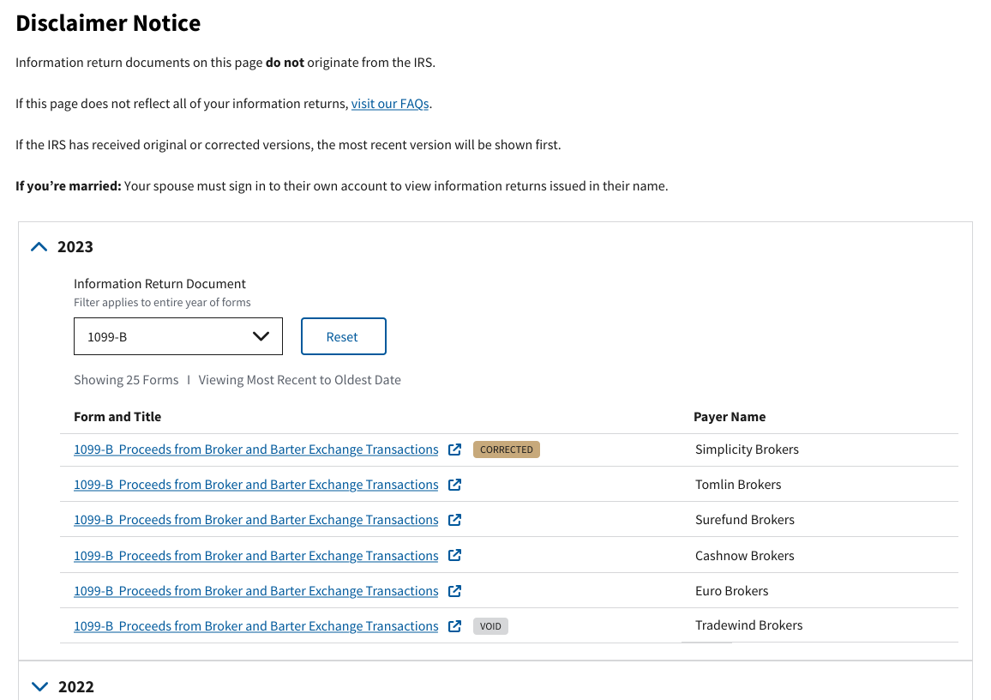
Information Return Documents
How It Works
View information return documents for current and preceding tax years.
Includes Forms W-2, 1099 series, 1098, and 1095-A.
12

Slide 32
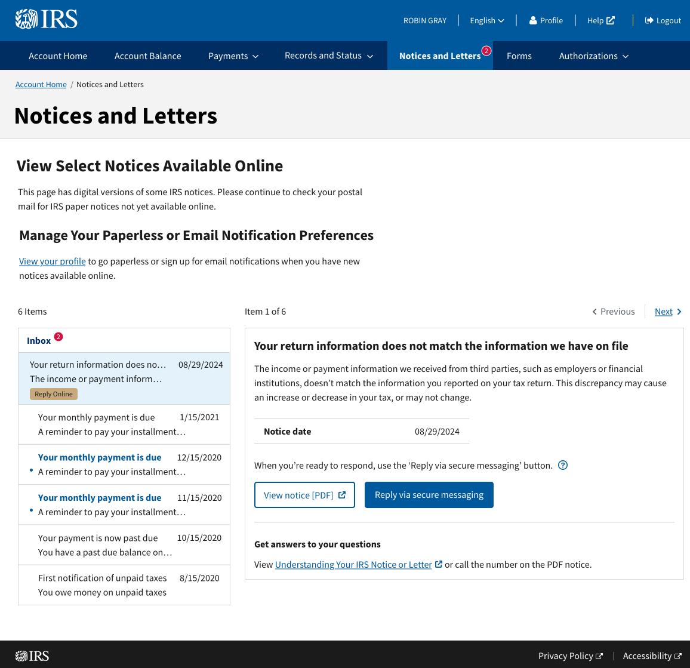
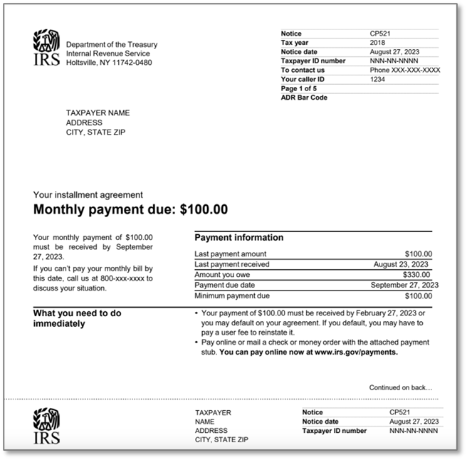
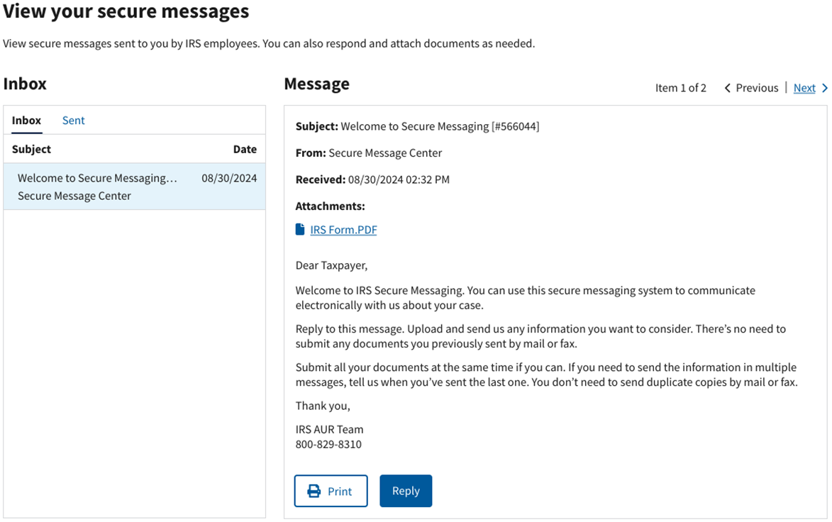
Notices and Letters
How It Works
View digital copies for over 250 CP notices.
Download PDF notice.
Reply via secure messaging to CP2000 notices.
View indicators for read and unread notices
13

Slide 33
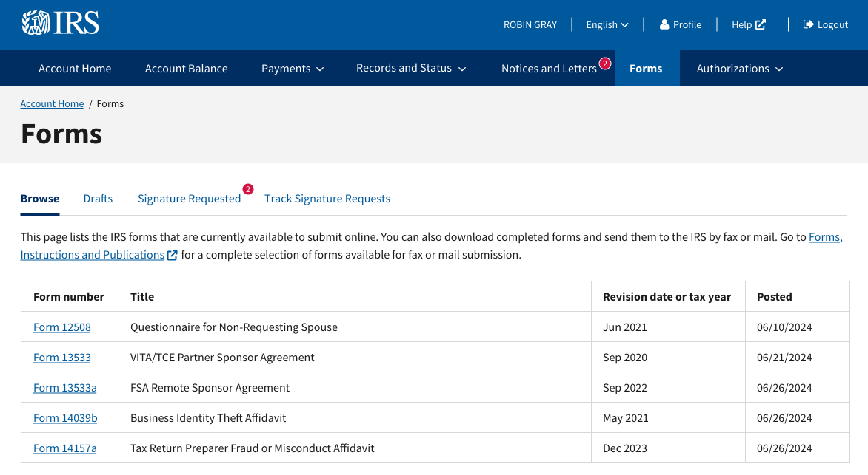
Forms
What’s Available
Digitally complete and submit forms that require your signature.
Spouses may also receive completed forms in their own online account for individuals and add their signature.
14

Slide 34
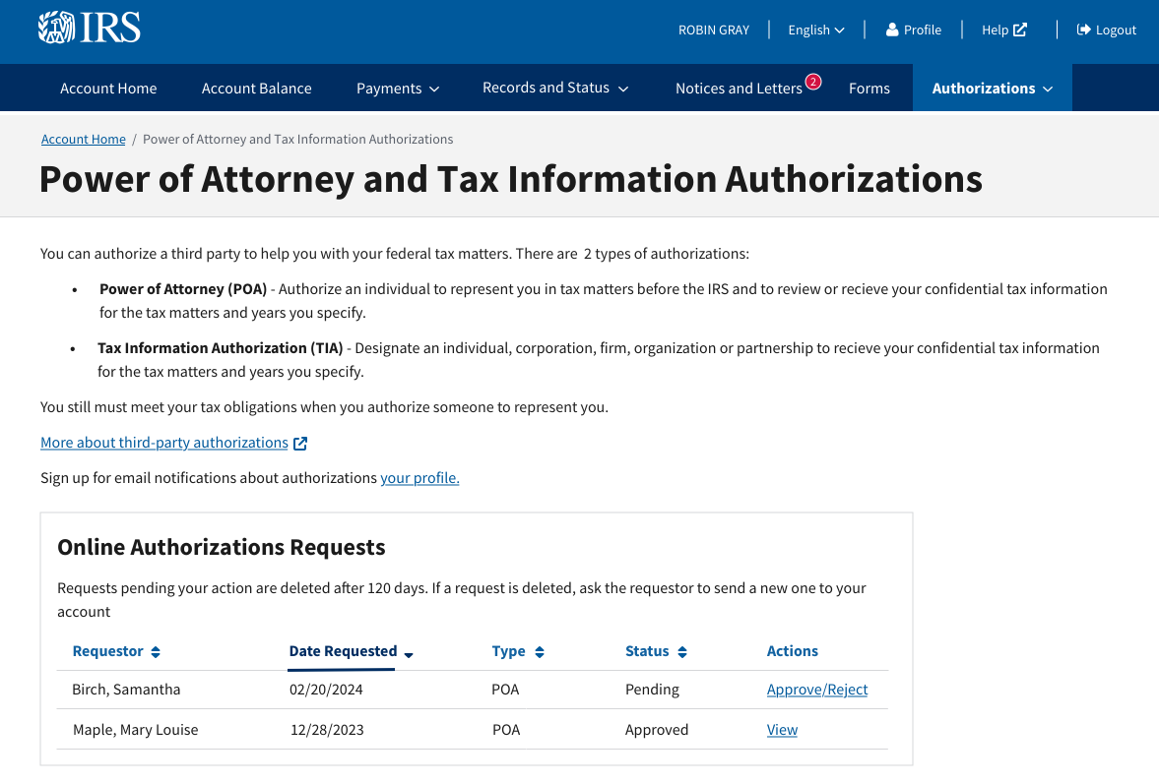
Authorizations
Authorizations
Review and approve Power of Attorney (POA) and Tax Information Authorization (TIA).
15

Slide 35
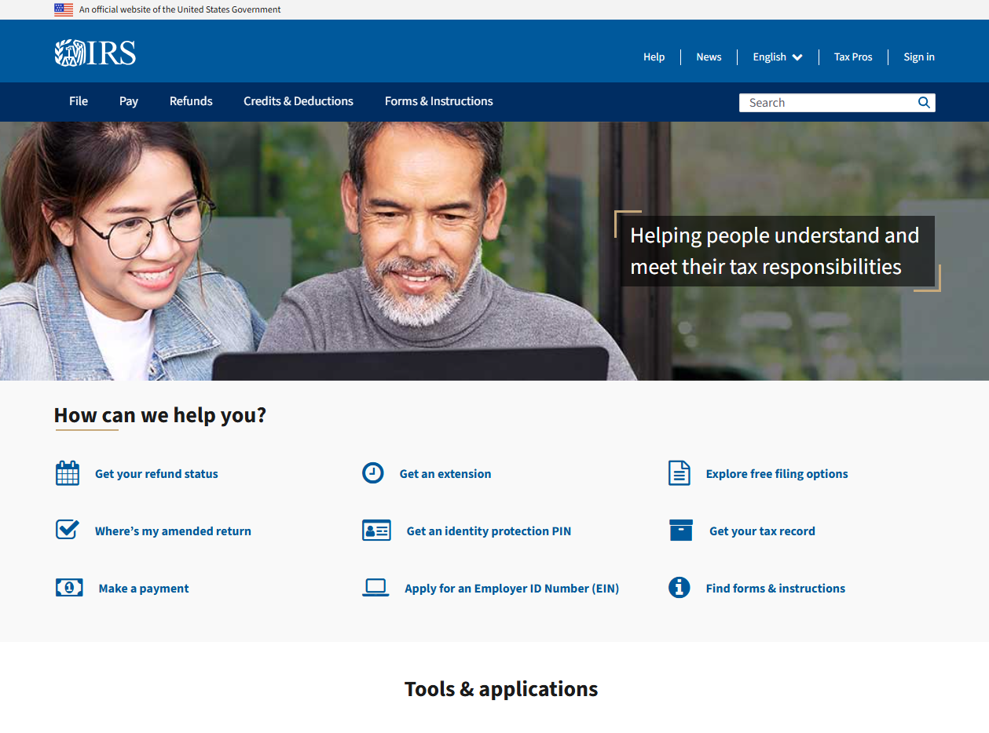
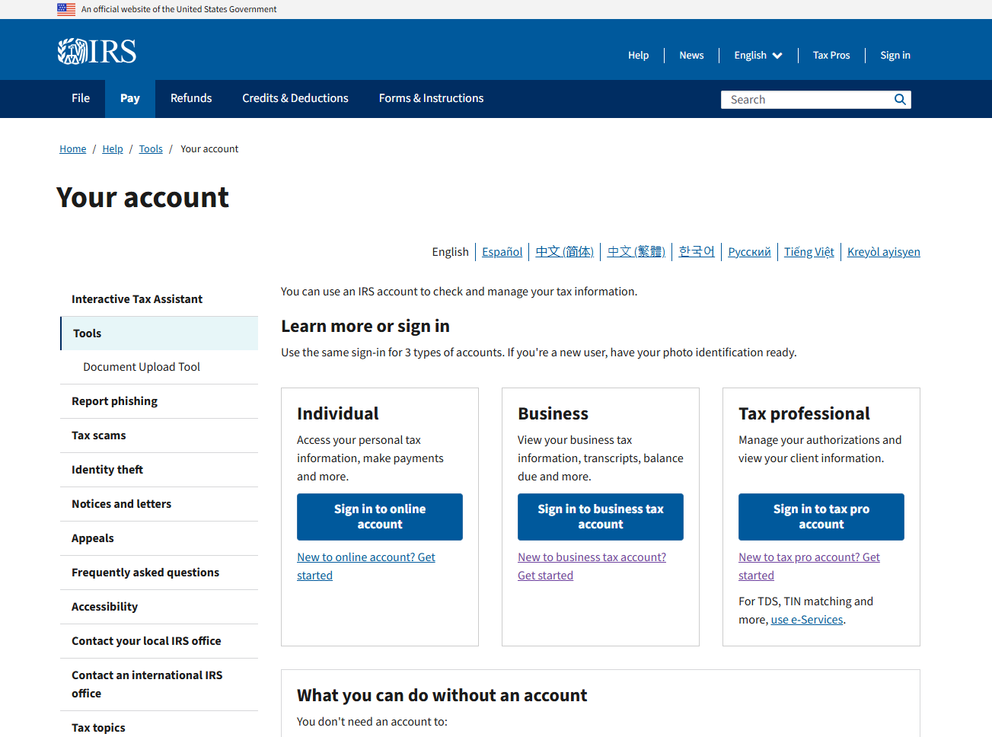
Log in to Online Account on IRS.gov
16

Slide 36
Executive Order (E.O.) 14247,
Modernizing Payments
to and from America’s Banking Account

Slide 37
Current State &
Drivers for Change
The IRS has been working to reduce paper tax refund payments for several years. The Executive Order is accelerating those efforts.
Historically for those taxpayers filing tax returns:
91.5% of individual taxpayers file with banking/direct deposit information
4% of businesses receive a direct deposit
About 800,000 direct deposits are rejected by financial institutions annually.
The IRS is focusing efforts to help taxpayers in this filing population, as well as those who are unbanked, to successfully submit banking information.

Slide 38
Transition Execution &
Communication Framework
The IRS is:
Changing business tax return forms to include fields for direct deposit information.
Communicating via press releases, FAQs, content on IRS.gov and more to keep the public updated as we move toward January 2026.
Leveraging the tax industry, software providers and tax practitioners to amplify messages on what to expect.
Partnering with Bureau of Fiscal Service on new or updated tools for the diverse demographics of IRS customers.
Expanding refund options for IRS customers to include:
    Direct deposit to checking or savings accounts.
    Use of reloadable debit cards.
    Use of accounts associated with digital payments.

Slide 39
Future State & Priorities
Key Changes Starting in January 2026:
Businesses and Individuals should provide direct deposit information when tax returns are filed.
The IRS will send letters to individuals asking them to update their banking information if they do not provide it on their tax return, or if a direct deposit has been rejected by their financial institution.
If their banking information is missing when filing electronically, the individual will receive an alert or message. The tax return will still be accepted and processed.
    The taxpayer will receive a notice requesting banking information or a reason it cannot be provided within 30 days. In addition, Where’s My Refund will provide messaging associated with the need for banking information. The taxpayer can use the Individual Online Account to provide their information.
    A tax refund will be held for up to 6 weeks from when the tax return is processed in our system. Once the taxpayer provides the direct deposit information or exception, the refund will be immediately released via direct deport or paper check. After 6 weeks, the refund will be released as a paper check, if there are no other issues with the tax return.
    Individual Online Account will be expanded to capture the banking information or reason for an exception for those receiving a notice.
    IRS will have a phone extension for taxpayers to provide an exception, if Individual Online Account is not an option.
    Customer Service Representatives cannot take direct deposit information over the phone or in-person.

Slide 40
Future State & Priorities Contd.
There are multiple options for most individual taxpayers to receive direct deposits. The IRS and Treasury will continually promote resources for opening a free or low-cost account by visiting FDIC: GetBanked and MyCreditUnion.gov for account options.
Many of the tax software companies and practitioners offer reloadable debit cards. This may be an option for some taxpayers.
The Future Beyond 2026:
Opportunities to have similar processes for those individuals filing amended tax returns.
Improve access and work around International refunds and access to digital payments.
Incorporate any learnings from 2026 to improve the experience and expand direct deposit activities further in 2027.
Possible updated guidance in the Summer of 2026. Stay tuned on IRS.gov and published material.

Slide 41

41

