Slide 1

Resources & Guidance for the
2025 Tax Filing Season
Communications & Liaison
Stakeholder Liaison
Dan Arnell Belarmino, Senior Stakeholder Liaison

Slide 2
Overview
Getting IRS Help
    Navigating the IRS
    Individual Online Account
    Taxpayer Assistance Centers
Resources Getting Ready to file
    Free Tax Return Preparation
    Choosing a Return Preparer
    Refund Status & Payments
Claiming Tax Credits and Deductions
    Earned Income Tax Credits & Child Tax Credit
    American Opportunity Credit & Premium Tax Credit
    Deductible Expenses
Protecting against Identity Theft
    Dirty Dozen
    IP PIN
Wrap Up
    Important Considerations
    Connect with us
    Got Questions? Issues or Feedback?

Slide 3
Communications & Liaison
Stakeholder Liaison
Getting IRS Help

Slide 4
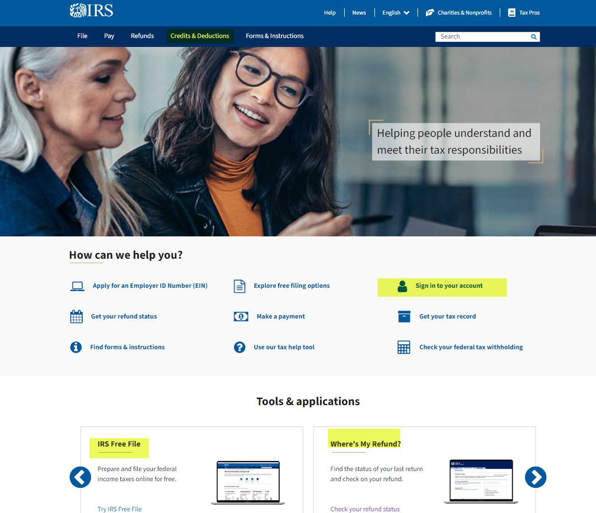
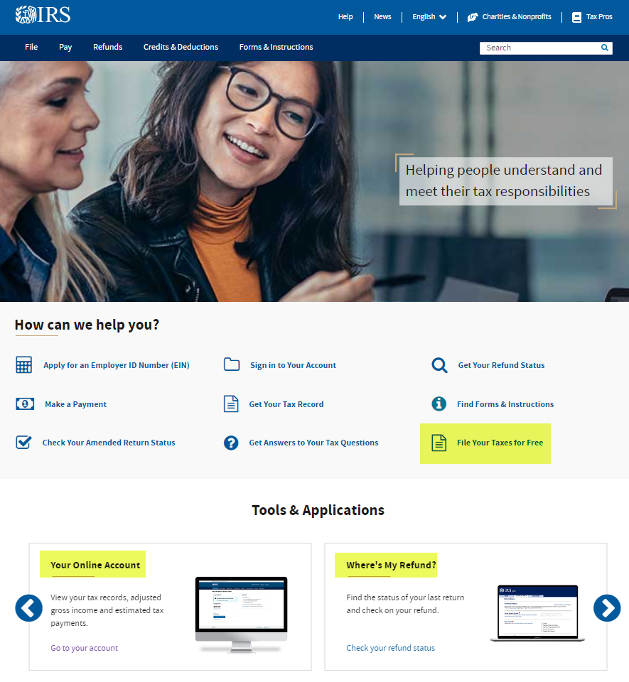

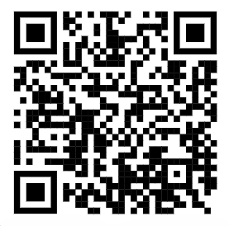
Navigating the IRS?
Start here…
www.irs.gov
www.irs.gov/help/tools

Slide 5
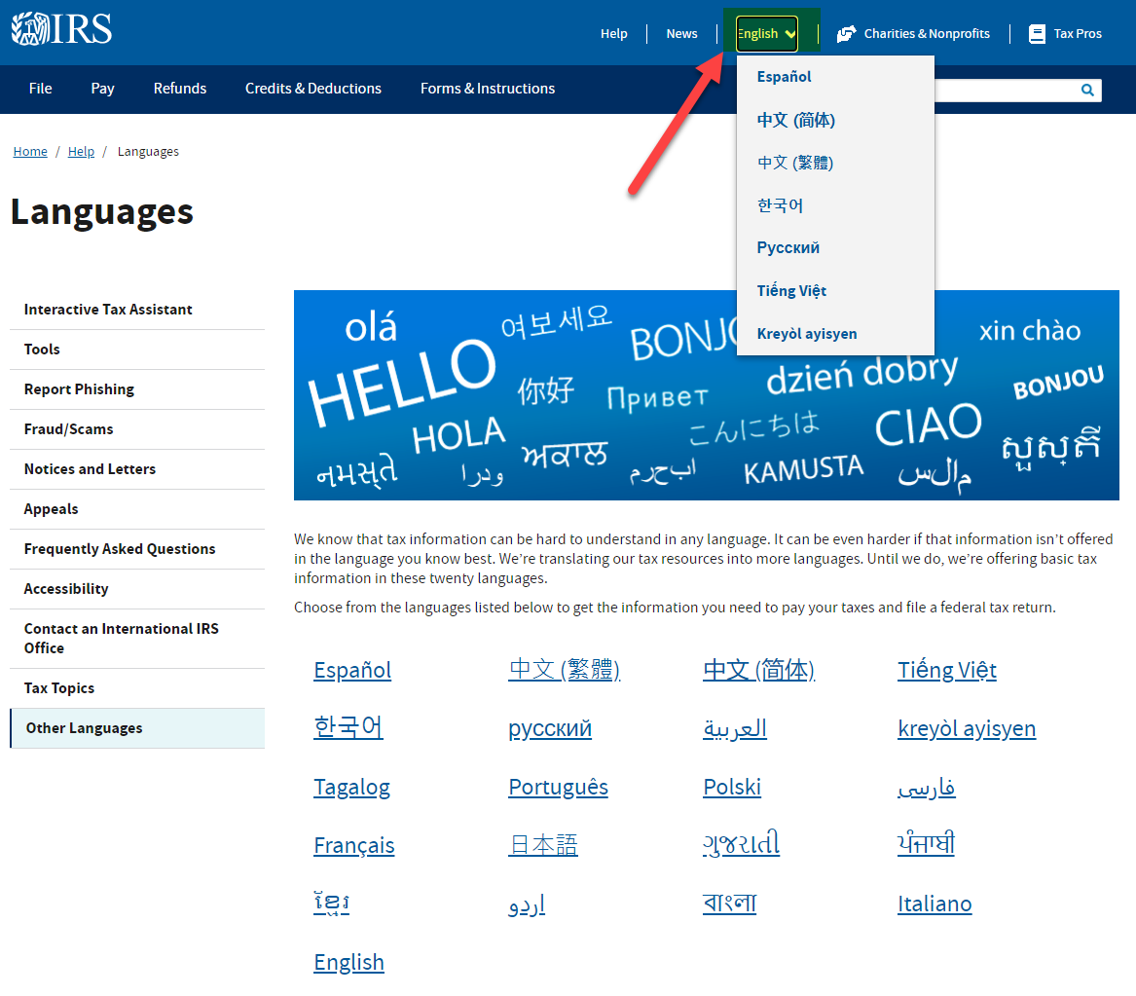
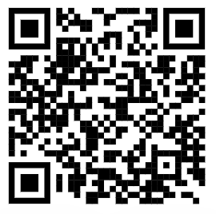
IRS.gov in 21 Languages https://www.irs.gov/help/languages

Slide 6
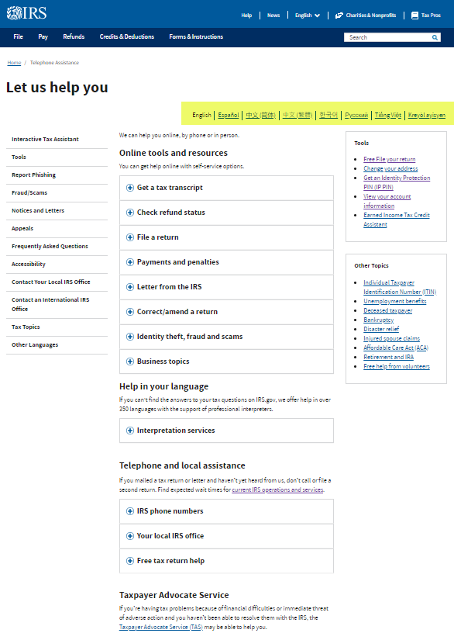
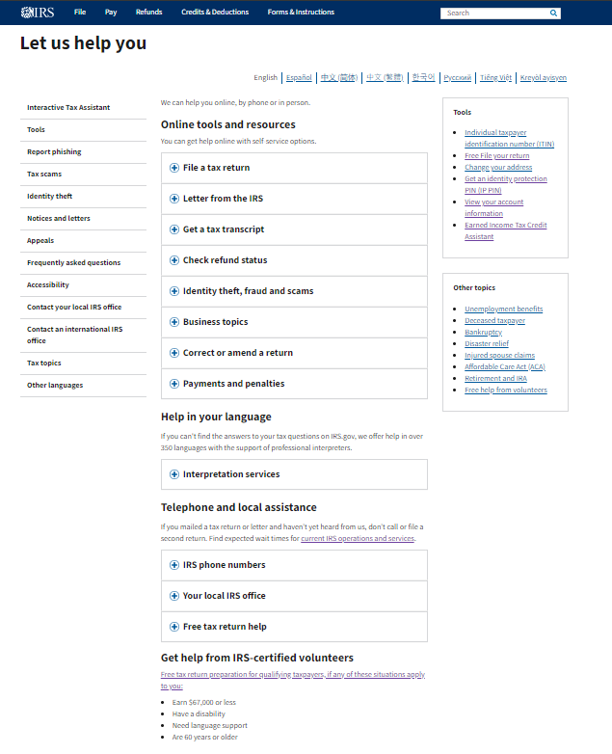
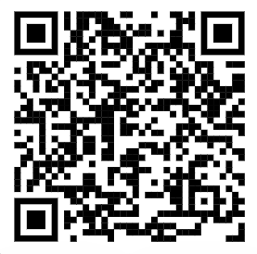
Have Questions? Need Help? http://www.IRS.gov/Help

Slide 7
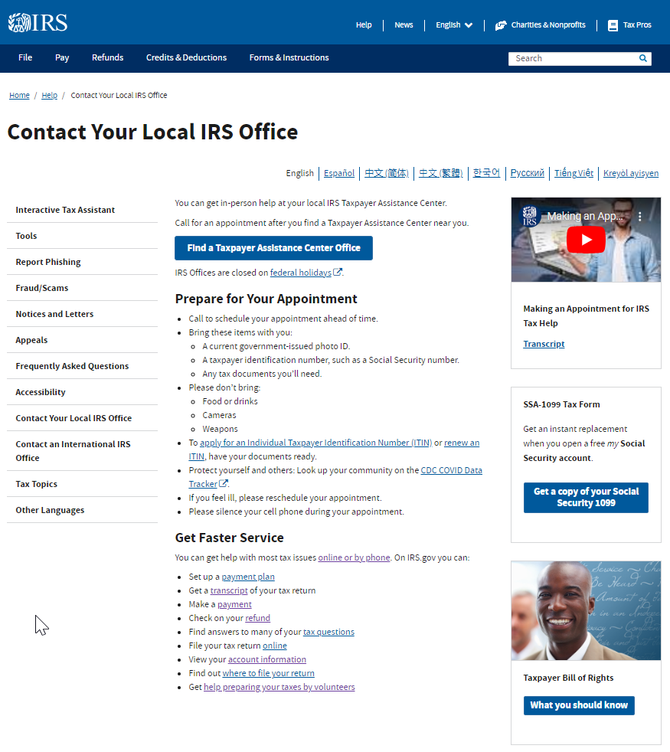
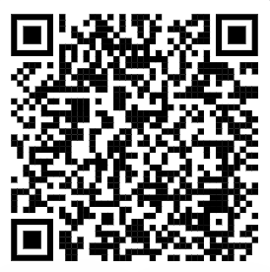
IRS Taxpayer Assistance Centers
Search “TAC” on IRS.gov

Slide 8
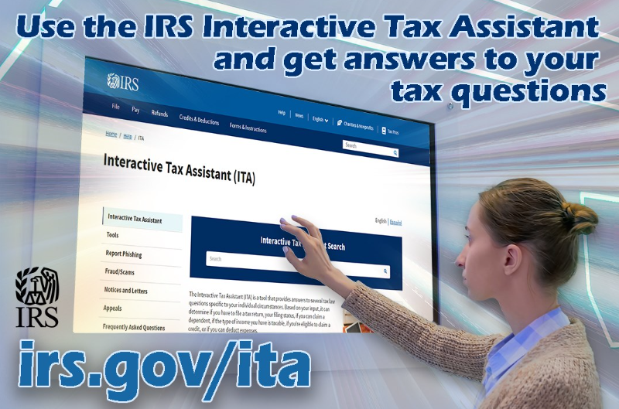
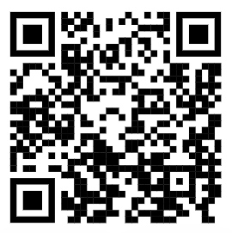
IRS Interactive Tax Assistant www.IRS.gov/help/ITA

Slide 9



IRS Individual Online Account
www.IRS.gov/account
For Individual Taxpayers, Sole Proprietors, or Single Member LLCs that report income on (Schedule C) using SSN
Publication 5533 Individual Online Account

Slide 10
Communications & Liaison
Stakeholder Liaison
Getting Ready to File

Slide 11
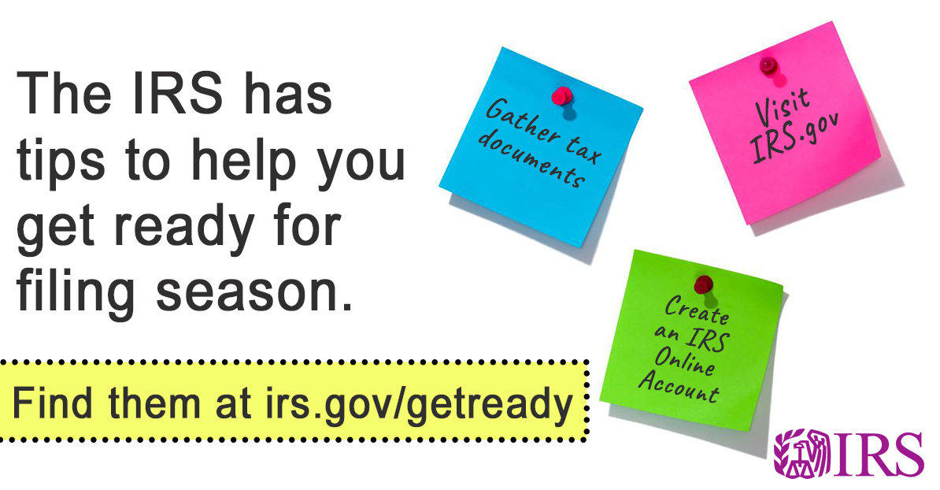
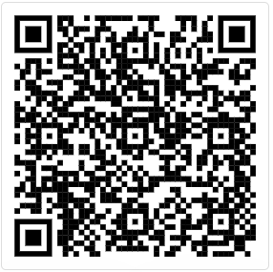
Getting Ready to File

Slide 12
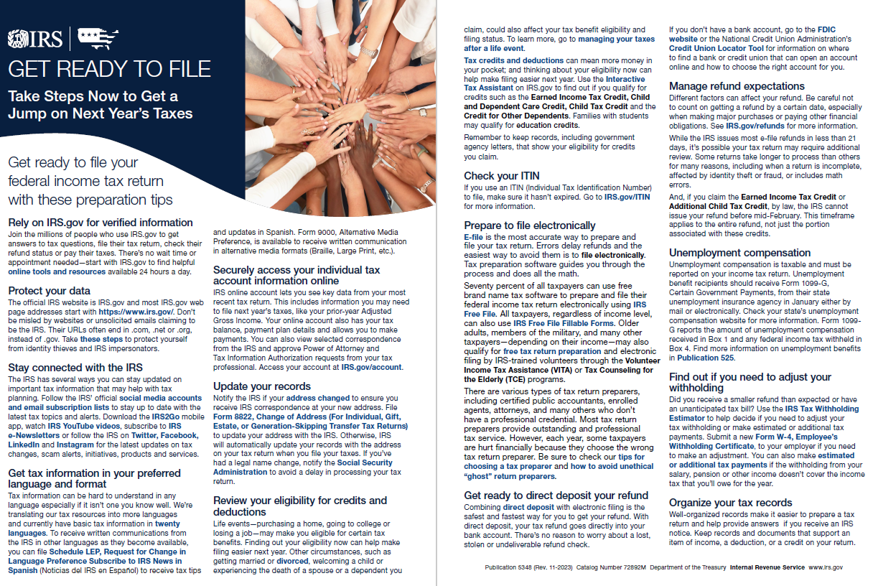
Pub 5348 Get Ready to File (Spanish)

Slide 13
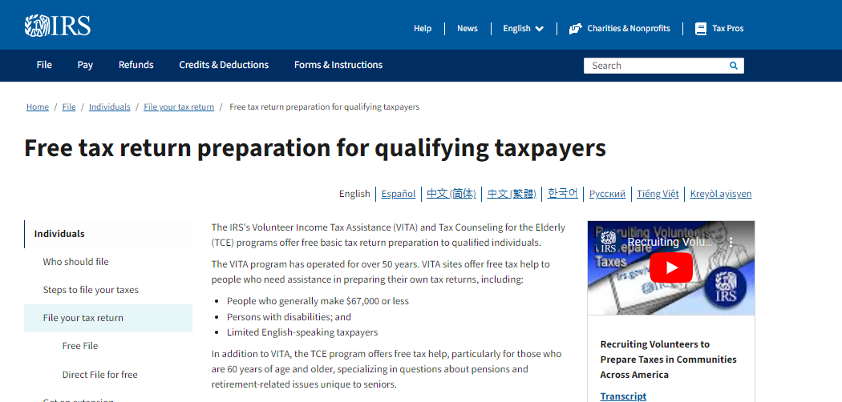
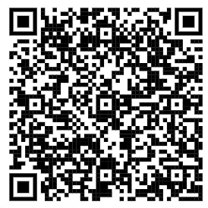
Free Tax Return Preparation
Volunteer Income Tax Assistance
www.IRS.gov/VITA

Slide 14
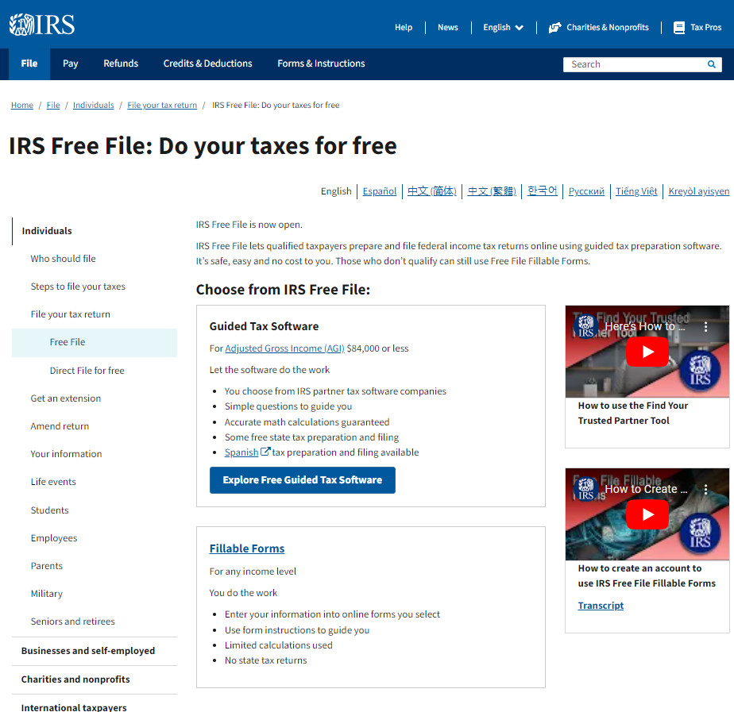
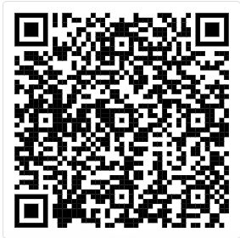
Free Tax Return Preparation
Free File
www.IRS.gov/FreeFile

Slide 15

Choosing a Paid Preparer

Slide 16
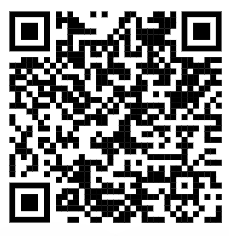
Choosing a Paid Preparer
Avoid preparers who claim to get larger refunds
Avoid preparers who base fees on refund amounts
Avoid paid preparers who won’t sign the return or won’t give you a copy
Never sign a blank tax return / review before signing
Availability of the preparer
Make sure that the paid preparer has a valid IRS Preparer Tax Identification Number (PTIN)
IRS.gov and search “choosing a preparer”

Slide 17
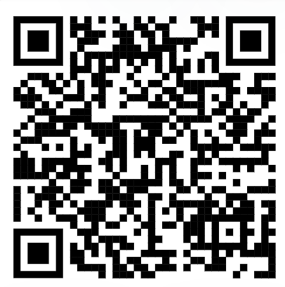
Reporting Abusive Tax Schemes
Complete Form 14242, Report Suspected Abusive Tax Promotions or Preparers
    Submit online or mail/fax to the IRS Lead Development Center
          Internal Revenue Service Lead Development Center
          Stop MS5040
          24000 Avila Road
          Laguna Niguel, CA 92677-3405
          Fax: 877-477-9135

Slide 18
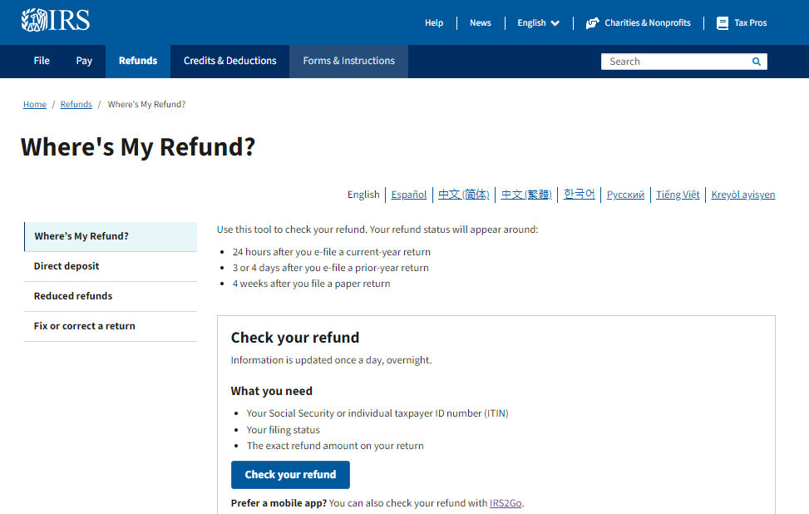
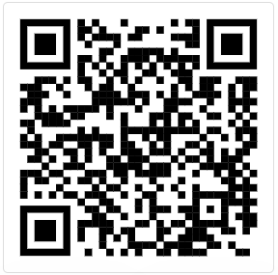
Tax Refund Status www.irs.gov/refunds

Slide 19
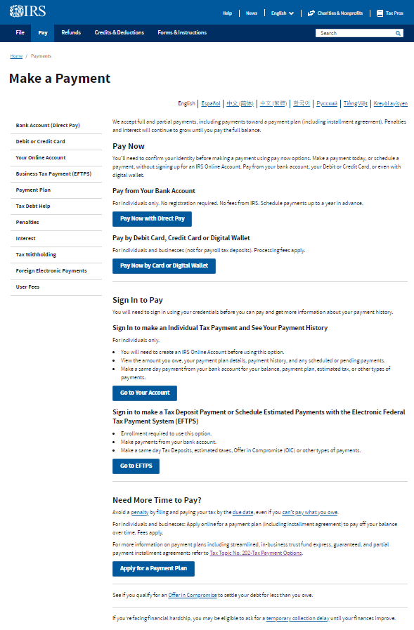
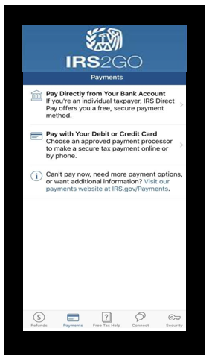
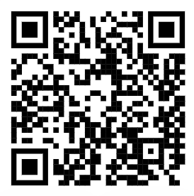
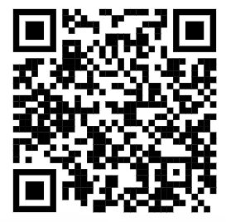
Pay Online at www.IRS.gov/payments and www.IRS.gov/IRS2GO

Slide 20
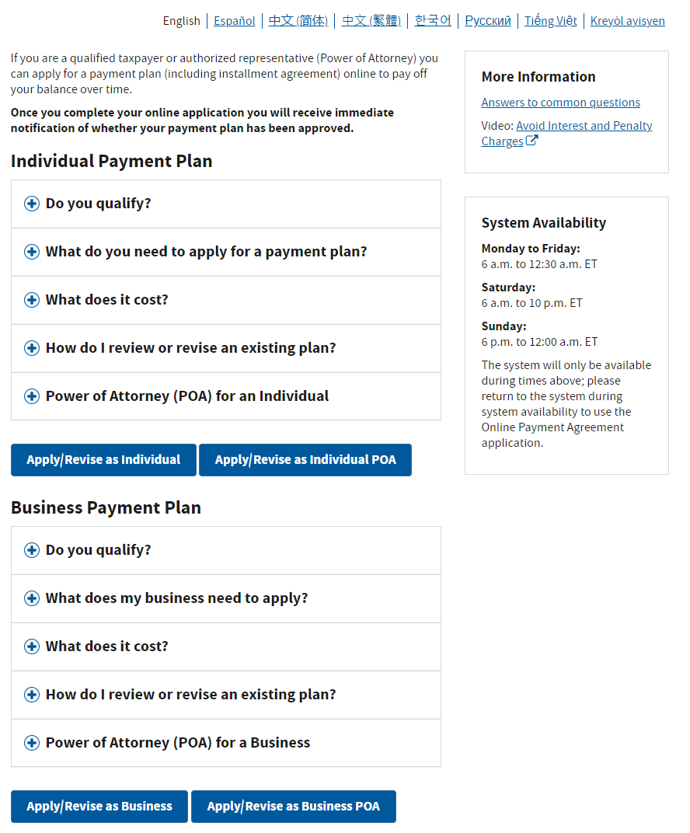
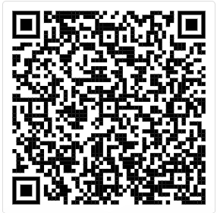
Payment Plan

Slide 21
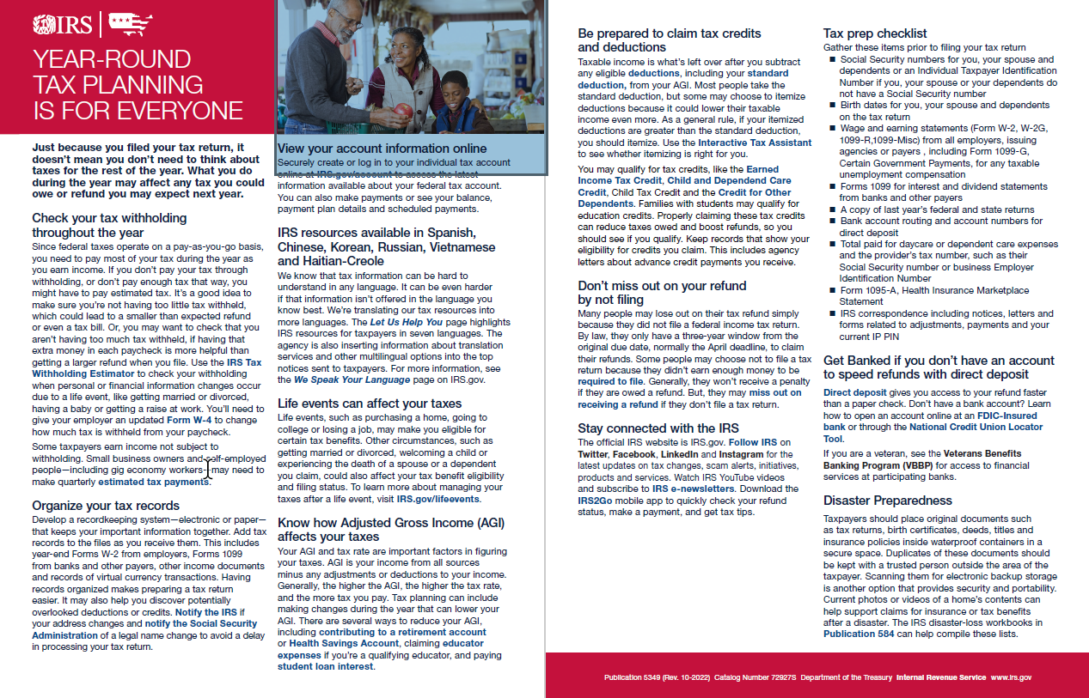
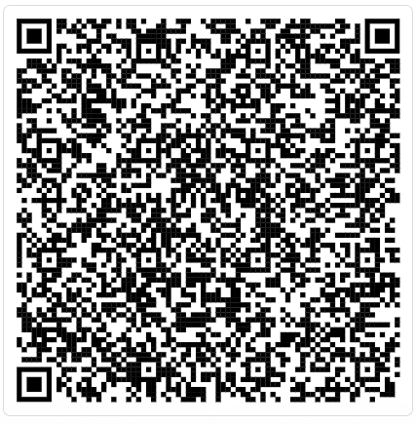
Pub 5349 Year-round Tax Planning is for Everyone

Slide 22


Form 1099-K

Slide 23
Communications & Liaison
Stakeholder Liaison
Claiming Tax Credits and Deductions

Slide 24

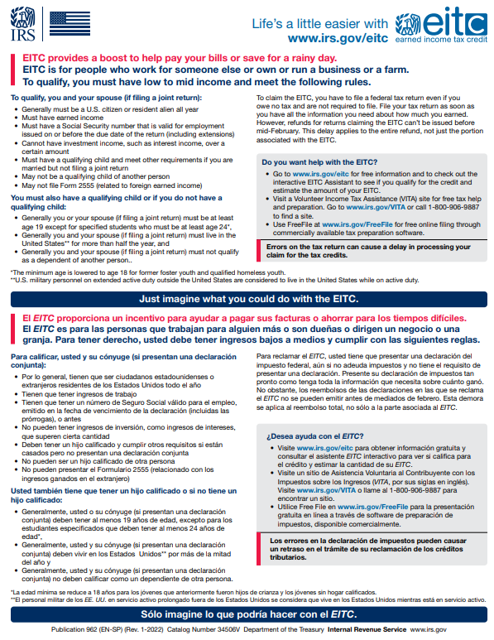

Earned Income Tax Credit Pub 5998 www.IRS.gov/EITC
ion Bundle
Earned Income Tax Credit (EITC) helps low-to-moderate
income workers.
Earned Income Tax Credit (EITC) Assistant

Slide 25

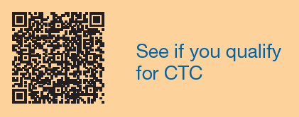
Child Tax Credit Pub 5811 www.IRS.gov/CTC
ion Bundle
Child Tax Credit (CTC) helps families with children.
Child Tax Credit (CTC) Eligibility Tool qualify for the Earned Income Tax Credit? The Earned Income Tax Credit (EITC) is for people who work for someone else, are self-employed or receive certain

Slide 26


American Opportunity Tax Credit Pub 4772 www.IRS.gov/AOTC
American Opportunity Tax Credit (AOTC) helps taxpayers who pay higher education expenses.
American Opportunity Tax Credit (AOTC) Eligibility Tool qualify

Slide 27


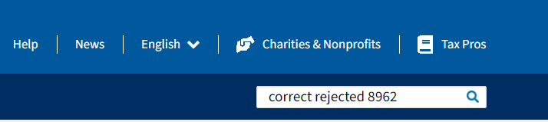
Premium Tax Credit Pub 5120
Premium Tax Credit (PTC) helps taxpayers cover the premiums for health insurance purchased through the Health Insurance Marketplace.
Premium Tax Credit (CTC) Eligibility Tool qualify

Slide 28

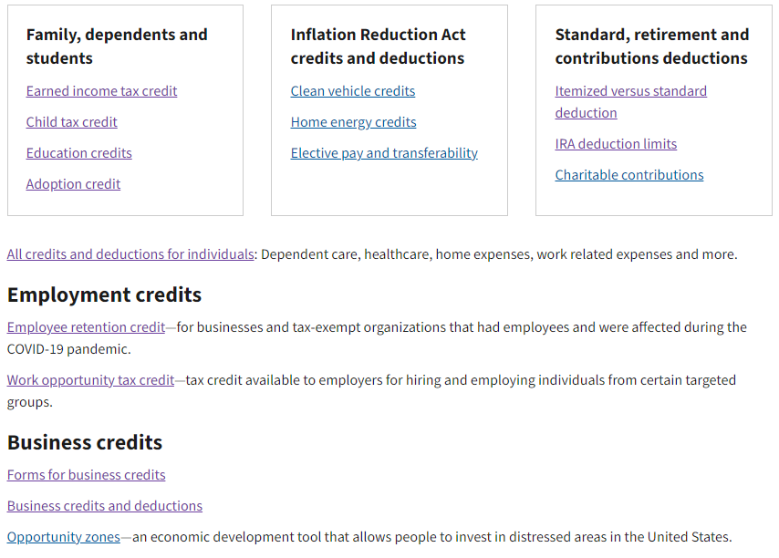
Tax Credits and Deductions www.IRS.gov/credits-and-deductions-for-individuals
How much will you SAVE this filing season?

Slide 29
Filing Season 2025 Deductions
Tax Year 2024
Standard Deductions
Single/Married Filing Separately $14,600
Married Filing Jointly $29,200
Head of Households $21,900
Over 65 or blind or Are a dependent on someone else’s return – See Publication 17
Deductible Expenses (Standard or Itemize)
Alimony payments
Business use of your car
Business use of your home
Money you put in an IRA
Money you put in health savings accounts
Penalties on early withdrawals from savings
Student loan interest
Teacher expenses
For some military, government, self-employed and
people with disabilities: work-related education expenses
For military servicemembers: moving expenses
Deductible Expenses (Itemize only)
Bad debts
Canceled debt on home
Capital losses
Donations to charity
Gains from sale of your home
Gambling losses
Home mortgage interest
Income, sales, real estate and personal property taxes
Losses from disasters and theft
Medical and dental expenses over 7.5% of your adjusted gross income
Miscellaneous itemized deductions
Opportunity zone investment

Slide 30
Communications & Liaison
Stakeholder Liaison
Protecting Against
Identity Theft

Slide 31

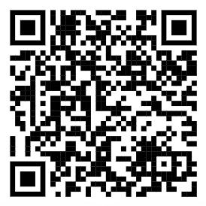
The IRS Dirty Dozen Tax Scams

Slide 32

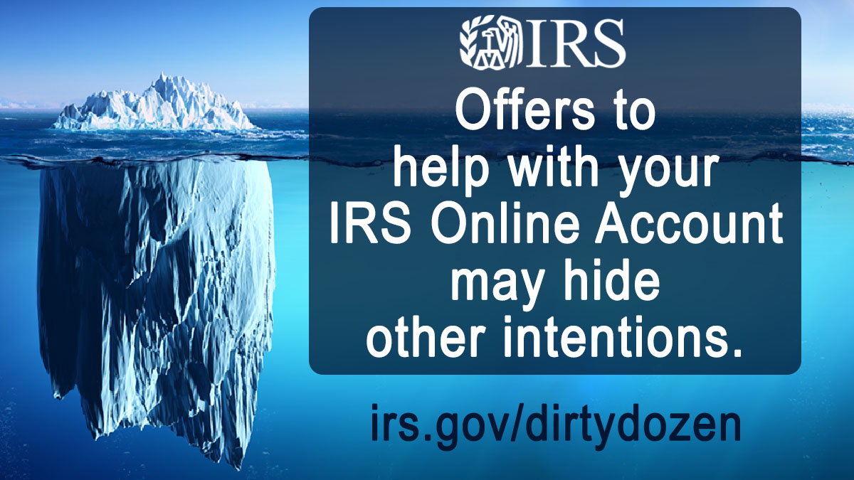


Don’t Fall for the Bait…

Slide 33

Beware of Tax Advice on Social Media

Slide 34

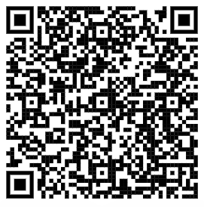
Stay Safe by Using an Identity Protection Pin (IP PIN)
Use an Identity Protection (IP) PIN when filing a tax return, including amended or prior year returns
The IRS will never ask you for your IP PIN
Protect your IP PIN and only share it with trusted tax software provider or tax preparer
Pub 5461-B Get an Identity Protection PIN

Slide 35
Communications & Liaison
Stakeholder Liaison
Wrap Up

Slide 36

Communications & Liaison
Stakeholder Liaison

Slide 37
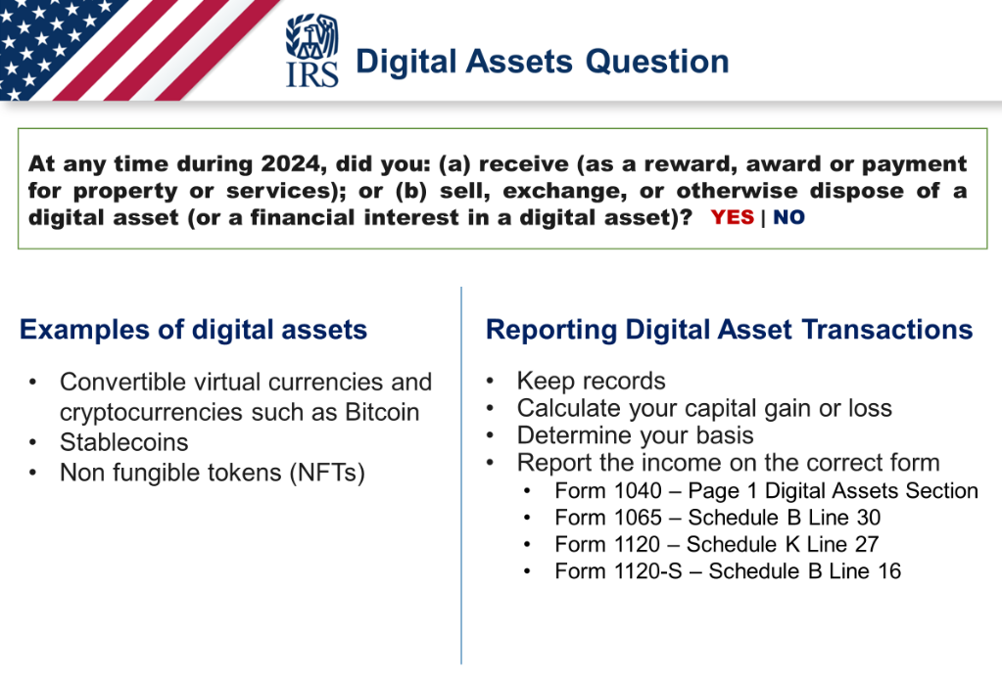
Communications & Liaison
Stakeholder Liaison

Slide 38

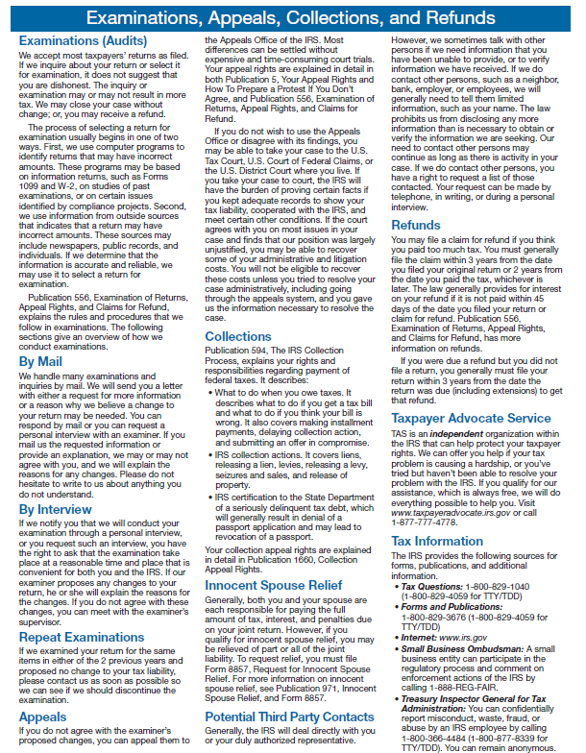
Taxpayer Bill of Rights
Publication 1
www.IRS.gov/TBOR

Slide 39
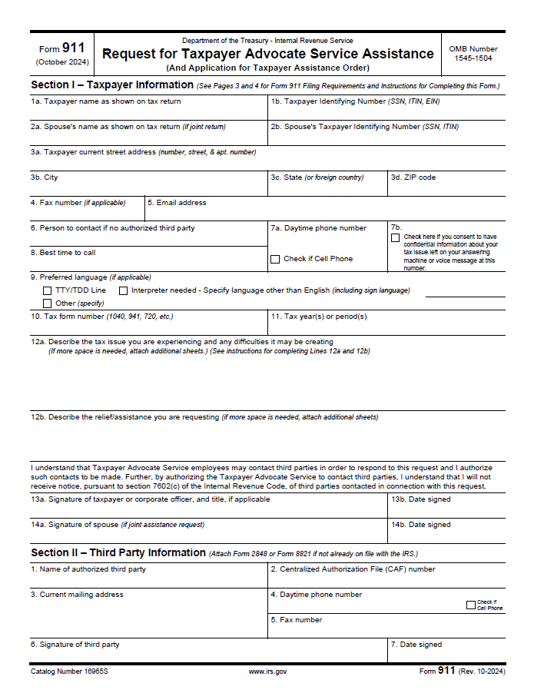
Taxpayer Advocate Service
ABOUT TAS
Independent organization within the IRS
Provide free service to all eligible taxpayers, including:
  Individual taxpayers
  Businesses
  Tax-exempt organizations
  More
No income limits for eligibility
taxpayeradvocate.irs.gov

Slide 40
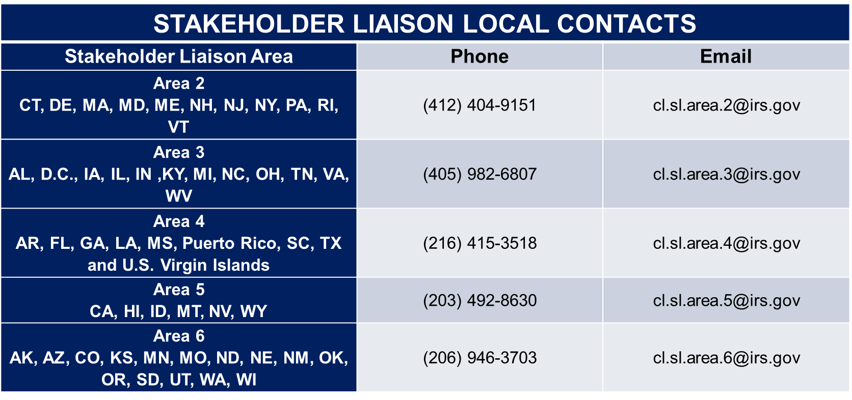
Stakeholder Liaisons
www.irs.gov Search: Stakeholder Liaison

Slide 41

Questions?

